Slide 1
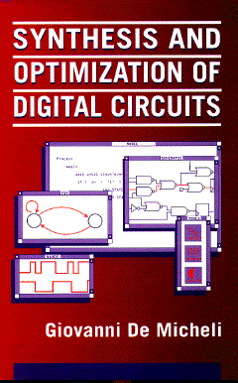


Libraries and Mapping
Giovanni De Micheli
Integrated Systems Laboratory
This presentation can be used for non-commercial purposes as long as this note and the copyright footers are not removed
© Giovanni De Micheli – All rights reserved

Slide 2
Module 1
Objective
  Libraries
  Problem formulation and analysis
  Algorithms for library binding based on structural methods

Slide 3
Library binding
Given an unbound logic network and a set of library cells
  Transform into an interconnection of instances of library cells
  Optimize delay
    (under area or power constraints)
  Optimize area
    Under delay and/or power constraints
  Optimize power
    Under delay and/or area constraints
Library binding is called also technology mapping
  Redesigning circuits in different technologies
Notes:
Cell-library binding is the task of transforming an unbound logic network into a bound network, i.e. into an interconnection of components that are instances of elements of a given library.
This step is very important for standard-cell and array-based semicustom circuit design, because it provides a complete structural representation of the logic circuit which serves as an interface to physical design tools.
Library binding allows us to retarget logic designs to different technologies and implementation styles. Hence it is of crucial importance for updating and customizing circuit designs.
Library binding is often called technology mapping.
The origin of this term is due to the early applications of semicustom circuits, which re-implemented circuits, originally designed in TTL SSI bipolar technologies, in LSI CMOS technologies.

Slide 4
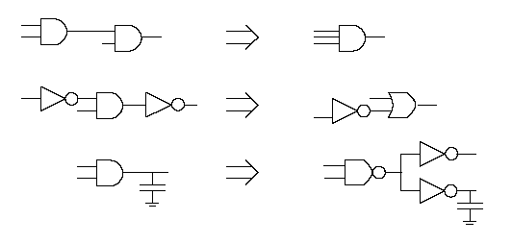
Major approaches
Rule-based systems
  Generic, handle all types of cells and situations
  Hard to obtain circuit with specific properties
  Data base:
    Set of pattern pairs
    Local search: detect pattern, implement its best realization
Heuristic algorithms
  Typically restricted to single-output combinational cells
  Library described by cell functionality and parameters
Most systems use a combination of both approaches:
  Rules are used for I/Os, high buffering requirements, …
Notes:
Practical approaches to library binding can be classified into two major groups: heuristic algorithms and rule-based approaches.
Whereas most binding algorithms are limited to single-output combinational cells, rule-based approaches can handle arbitrarily complex libraries, including multiple-output, sequential and interface elements (e.g. Schmitt triggers and three-state drivers).
The drawbacks of the latter methods is the creation and maintenance of the set of rules as well as the speed of execution.
Most commercial tools use a combination of algorithms and rules in library binding, to leverage the advantages of both.

Slide 5
Library binding: issues
Matching:
  A cell matches a sub-network when their terminal behavior is the same
  Tautology problem
  Input-variable assignment problem
Covering:
  A cover of an unbound network is a partition into sub-networks which can be replaced by library cells
  Binate covering problem
Notes:
There are two fundamental problems in library binding.
Matching is determining if a cell can replace a subnetwork, and what type of connection (e.g., input permutation) is necessary.
Covering is determining a partition of the network into blocks, each one matching a cell in the library.
The latter problem is more difficult in practice, because it is a binate covering problem.
The binate nature stems from the fact that each cell requires other cells to produce its inputs.

Slide 6
Assumptions
Network granularity is fine
  Decomposition into base functions:
  2-input AND, OR, NAND, NOR
Trivial binding
  Use base cells to realize decomposed network
  There exists always a trivial binding:
    Base-cost solution…
Notes:
For the sake of explaining the problem complexity, let us assume first that the network is decomposed into simple functions, such as 2-input NANDs and NORs.
Then, since libraries contain these elements, there is a trivial one to one binding.
This trivial binding can provide a base cost to improve upon.

Slide 7
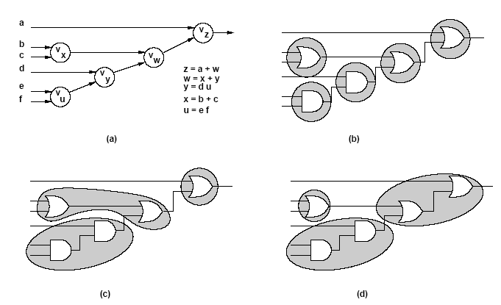
Example
Notes:
This example shows a network and its trivial binding.
Assuming that 3-input NANDs and NORs are available in the network, there are two non-trivial bindings.
The choice among them depends on the objective and the boundary conditions.
For example, if optimizing for timing, the network in ( c ) is better than the network in ( d ) according to the arrival time of the top input.

Slide 8
Example
Library
Cost
a
v₂
y
AND2
4
x = b + c
y = ax
z = xd
b
OR2
4
v₁
x
c
OA21
5
v₃
d
z
m₁: {v₁,OR2}
a
y
m₂: {v₂,AND2}
v₂
b
x
m₃: {v₃,AND2}
v₁
x
c
m₄: {v₁,v₂,OA21}
z
v₃
d
m₅: {v₁,v₃,OA21}
Notes:
Consider the simple library and the network
A trivial binding is shown in ( c ).
A more interesting binding can be found by considering the possible matches.
Consider, for example, vertex v1 that can be bound to a two-input OR gate, and vertex v2 that can be bound to a two-input AND gate.
Moreover, the subnetwork consisting of {v1,v2} can be bound to a complex gate OA21.
We can associate binary variables to denote the matches.
Variable m_1 is true whenever the OR2 gate is bound to v1, variable m_2 is true whenever the AND2 gate is bound to v2, and so on…

Slide 9
Example
Vertex covering:
  Covering v₁ : ( m₁ + m₄ + m₅ )
  Covering v₂ : ( m₂ + m₄ )
  Covering v₃ : ( m₃ + m₅ )
Input compatibility:
  Match m₂ requires m₁
    (m’₂ + m₁)
  Match m₃ requires m₁
    (m’₃ + m₁ )
Overall binate covering clause
  (m₁+m₄+m₅) (m₂+m₄)(m₃+m₅)(m’₂+m₁)(m’₃+m₁) = 1
v₂
v₁
x
v₃
Notes:
We can represent the requirement that v1 be covered by at least one gate in the library by the unate clause (m_1 + m_4 + m_5).
Similarly, the covering requirements of v2 and v3 can be represented by clauses (m_2 + m_4) and (m_3 + m_5) respectively.
In addition to these requirements, we must insure that the appropriate inputs are available to each chosen cell.
For instance, binding an AND2 gate to v2 requires that its inputs are available, which is the case only when a OR2 gate is bound to v1.
The former choice is represented by m_2 and the latter by m_1.
This implication can be expressed by the binate clause (m_2' + m_1).
And so on…
The overall binate clause is shown on the slide.

Slide 10
Heuristic approach to library binding
Split problem into various stages:
  Decomposition
    Cast network and library in standard form
    Decompose into base functions
    Example, NAND2 and INV
  Partitioning
    Break network into cones
    Reduce to many multi-input, single-output networks
  Covering
    Cover each sub-network by library cells
Most tools use this strategy
  Sometimes stages are merged
Notes:
The major difficulty in solving the library binding problem lies in the network covering problem.
To render the problem solvable and tractable, most heuristic algorithms apply
two pre-processing steps to the network before covering: decomposition and partitioning.
Decomposition is required to guarantee a solution to the network covering problem, by insuring that each vertex is covered by at least one match.
The goal of decomposition in this context is to express all local functions as simple functions, such as two-input NORs or NANDs, that are called base functions.
The library must include cells implementing the base functions, to insure the existence of a solution.
The second major pre-processing step in heuristic binding is partitioning, that allows the covering algorithm to consider a collection of multiple-input single-output networks in place of a multiple-input multiple-output network.
The rationale for partitioning is two-fold. First, the size of each covering problem is smaller.
Second, the covering problem becomes tractable under some additional assumptions

Slide 11
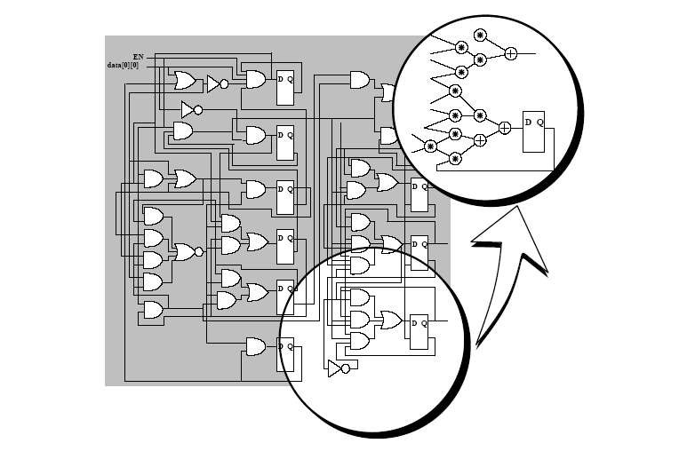
Decomposition
Notes:
Example of decomposition into AND/OR form.

Slide 12
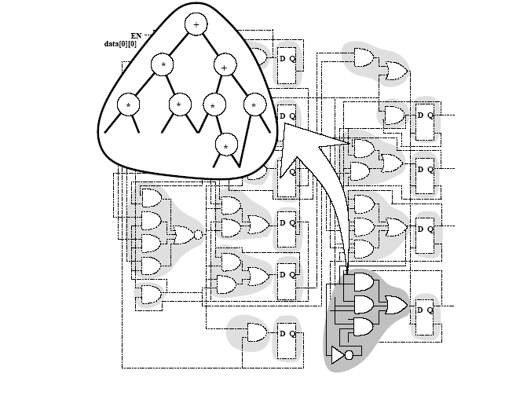
Partitioning
Notes:
Example of partitioning into logic cones.
Each multiple fanout point is cut, as well as input/outputs to registers.

Slide 13
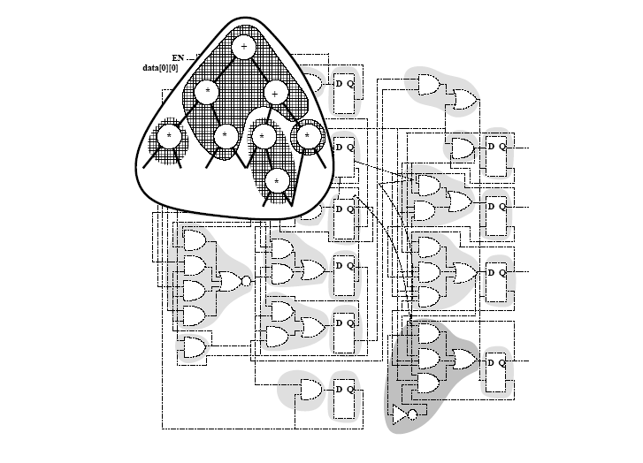
Covering
Notes:
Example of cover of a cone of logic. Shaded areas represent cells.

Slide 14
Heuristic algorithms
Structural approach
  Model functions by patterns
    Example: tree, dags
  Rely on pattern matching techniques
Boolean approach
  Use Boolean models
  Solve the tautology problem
    Use BDD technology
  More powerful
Notes:
Structural matching relies on the identification of common patterns.
For this reason, both the subject graph and the library functions must be cast into a form that is comparable.
Hence they are both decomposed in terms of the same set of base functions.
The graphs associated with the library elements are called pattern graphs.
Boolean matching relies on solving a tautology problem, i.e., in verifying that the network fragment and the cell have the same function.
Efficient techniques based on binary decision diagrams are used.

Slide 15
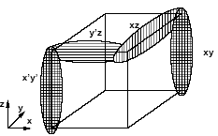
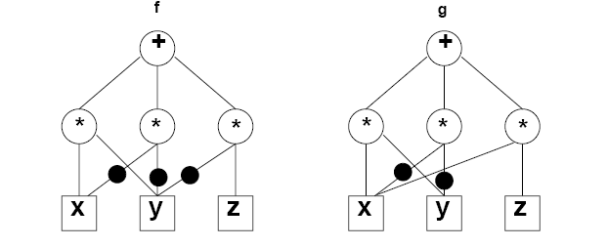
Example
Boolean vs. structural matching
f = xy + x’y’ + y’z
g = xy + x’y’ + xz
Function equality is a tautology
  Boolean match
Patterns may be different
  Structural match may not exist
Notes:
This example shows that two sop forms can be logically equivalent, still by having different structures.
Pattern matching, based on graphs or strings, would not find a match of these two expressions.

Slide 16
Structural matching and covering
Expression patterns
  Represented by dags
Identify pattern dags in network
  Sub-graph isomorphism
Simplification:
  Use tree patterns
Typical problems with EXORs and MAJority functions
Notes:
Structural matching involves pattern matching, and specifically checking if the library patterns appear in the subject graph.
Often, graphs are simplified to trees, to make matching easier.
In these case, cells like EXORs and majority functions are not easily recognized.

Slide 17
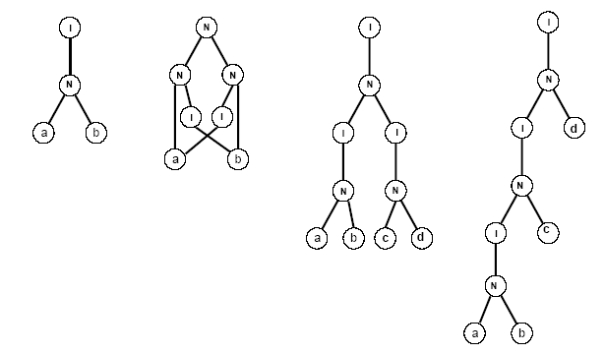
Example
Notes:
Here it is shown the following cell patterns in a library: a two-input AND gate, a two-input EXOR gate and a four-input AND gate,
The pattern graphs are expressed using a decomposition in two-input NANDs and inverters.
Note that there are two pattern graphs corresponding to the four-input AND gate.

Slide 18
Tree-based matching
Network:
  Partitioned and decomposed
    NOR2 (or NAND2) + INV
    Generic base functions
      Not much used
    Subject tree
Library
  Represented by trees
  Possibly more than one tree per cell
Pattern recognition
  Simple binary tree match
  Aho-Corasik automaton
Notes:
We consider now structural matching and covering using the tree-based representation.
We assume that the subject graph is represented by a rooted tree, obtained by splitting by leaves of the corresponding leaf-dag.
This is called a subject tree.
The library is also represented by a set of trees, with possibly more than one tree per cell when decomposition is not unique (e.g., AND4)
Pattern recognition can be done in general with the Aho-Corasik automaton, or with a much simpler technique when the base function is a NOR2 or a NAND2.

Slide 19
Example
SUBJECT TREE
PATTERN TREES
cost = 2
INV
cost = 3
NAND
cost = 4
AND
cost = 5
OR
Notes:
This example shows a subject tree and a simple library with 4 cells and related costs.

Slide 20
Example: Lib
Match of s: t1
cost = 2
Match of t: t1
cost = 2+3 = 5
Match of t: t3
cost = 4
Match of r: t2
cost = 3+2+4 =9
Match of r: t4
cost = 5+3 =8
Match of u: t2
cost = 3
r
r
r
r
r
s
t
s
t
s
t
s
t
s
t
u
u
u
u
u
Notes:
This example shows an animation of the dynamic programming algorithm that performs tree covering.

Slide 21
Tree covering
Dynamic programming
  Visit subject tree bottom up
At each vertex
  Attempt to match:
    Locally rooted subtree to all library cell
    Find best match and record
  There is always a match when the base cells are in the library
Bottom-up search yields and optimum cover
Caveat:
  Mapping into trees is a distortion for some cells
  Overall optimality is weakened by the overall strategy of splitting into several stages
Notes:
For all vertices of the subject tree, the covering algorithm determines the matches of the locally rooted subtrees with the pattern trees.
There are three possibilities for any given pattern tree.
- The pattern tree and the locally rooted subject subtree are isomorphic. Then, the vertex is labeled with the corresponding cell cost.
- The pattern tree is isomorphic to a subtree of the locally rooted subject subtree with the same root and a set of leaves L. Then, the vertex is labeled with the corresponding cell cost plus the labels of the vertices L.
- There is no match}
If we assume that the library contains the gates implementing the base functions, then for any vertex there exists at least one cell for which one of the first two cases applies, and we can label that vertex.
Therefore, it is possible to choose for each vertex in the subject graph the best labeling among all possible matches.
At the end of the tree traversal, the vertex labeling corresponds to an optimum covering.
Note that overall optimality is weakened by the fact that the total area of a bound network depends also on the partitioning and decomposition steps.
The complexity of the algorithm is linear in the size of the subject tree.

Slide 22
Different covering problems
Covering for minimum area:
  Each cell has a fixed area cost (label)
  Area is additive:
    Add area of match to cost of sub-trees
Covering for minimum delay:
  Delay is fanout independent
    Delay computed with (max, +) rules
    Add delay of match to highest cost of sub-trees
  Delay is fanout dependent
    Look-ahead scheme is required
Notes:
There are three different flavors of the covering algorithm.
Covering for minimum area. Areas are additive.
Covering for minimum delay, with fixed delay. The data-ready time at a node is the sum of the cell propagation delay and the maximum data ready time of its inputs.
Covering for minimum delay, with fanout-dependent delay. This problem requires some look ahead and it is described later.

Slide 23
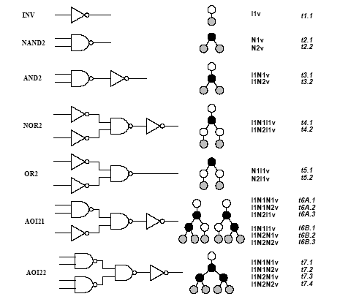
Simple library
Notes:
This is a simple library to be used in the next examples.

Slide 24
Example – minimum area cover
Area cost: INV:2 NAND2:3 AND2: 4 AOI21: 6
Network
Subject graph
Vertex
Match
Gate
Cost
o
x
t2
NAND2(b,c)
3
I
y
t1
INV(a)
2
w
z
t2
NAND2(x,d)
3+3 = 6
N
w
t2
NAND2(y,z)
3+6+ 2 = 11
y
z
o
t1
INV(w)
2+11 = 13
I
N
t3
AND2(y,z)
6 + 4 + 2 = 12
a
x
d
v
N
v
t6B
AOI21(x,d,a)
6 + 3 = 9
b
c
v
v
Notes:
This is an example of the covering algorithm for minimum area, and it is detailed in the textbook.

Slide 25
Example – minimum delay cover
Fixed delays: INV:2 NAND2:4 AND2: 5 AOI21: 10
All inputs are stable at time 0, except for t_{d} = 6
Network
Subject graph
Vertex
Match
Gate
Cost
o
x
t2
NAND2(b,c)
4
I
y
t1
INV(a)
2
w
z
t2
NAND2(x,d)
6+4 = 10
N
w
t2
NAND2(y,z)
10 + 4 = 14
y
z
o
t1
INV(w)
14 + 2 = 16
I
N
t3
AND2(y,z)
10 + 5 = 15
v
N
v
a
x
d
t6B
AOI21(x,d,a)
10 + 6 = 16
b
c
v
v
Notes:
This is an example of the covering algorithm for minimum delay, and it is detailed in the textbook.

Slide 26
Minimum-delay cover for load-dependent delays
Model
  Gate delay is d = α + β cap_load
  Capacitive load depends on the driven cells (fanout cone)
  There is a finite (possibly small) set of capacitive loads
Algorithm
  Visit subject tree bottom up
  Compute an array of solutions for each possible load
  For each input to a matching cell, the best match for the corresponding load is selected
Optimality
  Optimum solution when all possible loads are considered
  Heuristic: group loads into bins
Notes:
The problem of selecting a cell in a bottom-up traversal of the subject graph is not straightforward, because the input capacitance load of the following stages are unknown when matching.
Indeed the following stages correspond to vertices closer to the root and therefore yet to be bound.
In most libraries the values of input capacitances are a finite and small set.
Therefore we can use a load binning technique, which consists of labeling each vertex with all possible total load values or by an approximation.
This can be done as a pre-processing step.
The tree covering algorithm is extended by computing an array of solutions for each vertex, corresponding to the loads under consideration.
For each match, the arrival time is computed for each load value.
For each input to the matching cell, the best match for driving the cell (for any load) is selected and the corresponding data-ready time is used.
If all possible load values are considered, then the algorithm guarantees an optimum solution for the delay model within the tree modeling assumption.
Otherwise, it represents a heuristic method approximating the exact solution.
The computational complexity of the tree-covering approach is linear in the size of the subject tree and in the number of load values being considered.

Slide 27
Example – minimum delay cover
Delays: INV:1+load NAND2: 3+load AND2: 4+load AOI21: 9+load
All inputs are stable at time 0, except for t_{d} = 6
All loads are 1
Same as before !
Network
Subject graph
Vertex
Match
Gate
Cost
o
x
t2
NAND2(b,c)
4
I
y
t1
INV(a)
2
w
z
t2
NAND2(x,d)
6+4 = 10
N
w
t2
NAND2(y,z)
10 + 4 = 14
y
z
o
t1
INV(w)
14 + 2 = 16
I
N
t3
AND2(y,z)
10 + 5 = 15
v
N
v
a
x
d
t6B
AOI21(x,d,a)
10 + 6 = 16
b
c
v
v
Notes:
When all loads are constant, the propagation delays are fanout independent.
Thus there is no need for a specialized algorithm.

Slide 28
Example – minimum delay cover
Delays: INV: 1+load NAND2: 3+load AND2: 4+load AOI21: 9+load
All inputs are stable at time 0, except for t_{d} = 6
All loads are 1 (for cells seen so far)
Add new cell SINV with delay 1 + ½ load and load 2
The sub-network drives a load of 5
Notes:
We assume here that the tree has to drive a load = 5.
Also, we assume that we have a wider inverter, with load=2, and with faster response (SINV).

Slide 29
Example – minimum delay cover
Cost
Network
Subject graph
Vertex
Match
Gate
Load=1
Load=2
Load=5
o
x
t2
NAND2(b,c)
4
5
8
I
y
t1
INV(a)
2
3
6
w
z
t2
NAND2(x,d)
10
11
14
N
w
t2
NAND2(y,z)
14
15
18
y
z
o
t1
INV(w)
20
I
N
t3
AND2(y,z)
19
v
N
v
a
x
d
t6B
AOI21(x,d,a)
20
SINV(w)
18.5
b
c
v
v
Notes:
This example is fully detailed in the textbook.

Slide 30
Library binding and polarity assignment
Search for lower cost solutions allowing signals to be generated with inverted polarity
  More cells to choose from
Polarities can be adjusted at register and/or I/O boundaries
Within structural covering:
  Polarity assignment is handled by a smart trick
Within structural covering
  Polarity assignment is built into the formulation
Notes:
The goal of considering the polarity assignment problem together within library binding is to find the best cover, regardless of the polarity of the signals.
Hence a cover of lower cost can be found as compared to approaches that disregard the flexibility in choosing the signal polarities.
This is possible since all combinational inputs are usually generated by registers who have signals in both polarities and since outputs are connected to the registers themselves.

Slide 31
Structural covering and polarity assignment
Assume subject network is decomposed into base functions such as NAND2 and INV
Pre-process subject network by adding inverter pairs between NANDs
Provide I/Os with both polarity
Add to library inverter-pair cell 2INV to the library:
  Cell corresponds to a connection and has 0 cost
  Unnecessary 2INV will be removed by the algorithm
Apply bottom-up dynamic programming cover algorithm
Notes:
Consider the network and the library cells after decomposition into base functions. All connections between base gates are replaced by inverter-pairs, which do not affect the network and cell behavior. (Connections to or from inverters do not need to be replaced.)
This transformation can be easily applied to both the subject graph and the pattern graphs, by replacing selected edges by edge pairs with an internal vertex labeled as an inverter.
The dynamic programming covering algorithm can now take advantage of the existence of both polarities for each signal in the subject graph, in the search for a minimum (area or delay) cost solution.
It is important that the newly introduced inverters are removed, when they do not contribute to lowering the overall cost.
For this reason, a fake element is added to the library.
It consists of an inverter-pair, whose actual implementation is a direct connection, and whose cost is zero.
Because of the optimality of the covering algorithm, the cost of the bound network starting from an unbound network with inverter-pairs has lower (or at most equal) cost than the cost of a bound network derived without using inverter-pairs.
Note again that the optimality is within a tree.

Slide 32
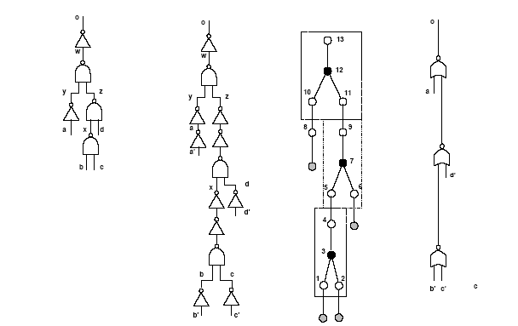
Example
Notes:
This example is described in the textbook.

Slide 33
General issues with covering
Decomposition and covering yield solutions that are locally sub-optimal at multiple fanout points
  Covering in various logic cones is independent
  High capacitive loads skews the solution
Approaches
  Implicit decomposition methods
    Compute and map all possible decompositions of a network
  Cell cloning and buffering at cone vertices
  Wavefront mapping
Notes:
Even though covering can be solved exactly, decomposition and partitioning hurt the quality of the overall solution.
Big loads at cones’ vertices skew the solutions, and loss of optimality is usually at multiple-fanout points.
A decomposition strategy was proposed by Lehman et al, where all possible decompositions in a cone are accounted for.
Also, cloning techniques that duplicate the cell at the cone vertex have been widely used.

Slide 34
Wavefront mapping
A wavefront is a sub-network
  Cutting all I/O paths
  With width W
When W is the circuit depth, then covering for load-dependent delays is optimum
  The entire network is covered
For reasonably smaller values of W, optimality is preserved
  The wavefront can be dynamically decomposed
  The wavefronit can be mapped (with duplications) for delay or other objectives
Notes:
Wavefront mapping is a technique based on the definition of a band (sub-network) that bisects the network.
Dynamic decomposition is done within the wavefront.
If the wavefront is very deep, there is no loss of optimality and covering is as usual.
For wavefront of smaller depths, there is often a good compromise between speed of execution and optimality.

Slide 35
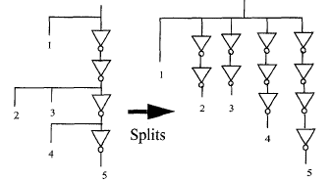
Buffering
Drive multiple sinks:
  Possibly with +/- polarities
  Possibly with different loads
  Possibly with different criticality
Logic/electrical effort theory
  delay = p + q gain
  gain = load/C_{in} is a design parameter
Issues:
  Determine minimal buffer tree delay
  Determine tree with minimal load
    satisfying all timing constraint
Solutions:
  Make electrical effort uniform in chains
    Closed form solution
  Adapt to non-continuous cell sizes and tree structure
    Gain based algorithm
Notes:
Buffering techniques are very important for speed.
Trees of buffers are used to generate the required current drive at the cone vertices.
Buffer trees are sized, using the theory of logical effort.
There are some related optimization problems, like determining the minimal buffer tree delay of the simplest tree that satisfies all timing requirements.

Slide 36
Module 2
Objectives
  Boolean covering
  Boolean matching
  Simultaneous optimization and binding
  Extensions to Boolean methods

Slide 37
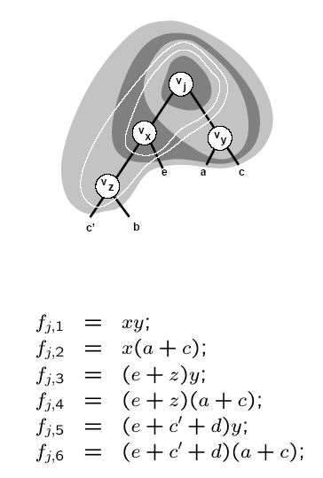
Boolean covering
Decompose network into base functions
Partition network into cones
Apply bottom-up covering to each cone
  When considering vertex v:
    Construct clusters by local elimination
    Limit the depth of the cluster by limiting the support of the function
    Associate several functions with vertex v
    Apply matching and record cost
Notes:
Boolean matching can overcome the pitfalls of structural matching.
Boolean matching requires an equivalence check between two functions, one representing a portion of the network and called cluster function
and the other representing a cell and named pattern function.
Boolean covering consist of identifying subnetworks, whose corresponding cluster functions have matches in the library, and in selecting an adequate set of matches that optimize the area and/or delay of the bound network.
Boolean covering is done bottom-up, as in the case of structural covering.

Slide 38
Boolean matching
P-equivalence
Cluster function f(x)
  Sub-network behavior
Pattern function g(y)
  Cell behavior
P-equivalence
  Is there a permutation operator P, such that f(x) = g ( P x)
  is a tautology?
Approaches:
  Tautology check over all input permutations
  Multi-rooted pattern ROBDD capturing all permutations
Notes:
Given a cluster and a pattern function, P-equivalence means looking for an input permutation that yields to identical functions.
P-equivalence can be done as a tautology check (with BDDs) over all input permutations, or by pre-constructing a multi-rooted BDD (for each pattern) representing already the permutations.

Slide 39
Input/output polarity assignment
NPN classification of logic functions
NPN-equivalence
  There exist a permutation operator P and complementation operators N_{i} and N_{o}, such that f(x) = N_{o} g ( P N_{i} x ) is a tautology
Variations:
  N-equivalence
  PN-equivalence
Notes:
Polarity assignment can be done in conjunction with Boolean matching.
Two functions are NPN equivalent, if they are equivalent modulo some input Negation (i.e., complementation) ), Permutation and output Negation.
N- equivalence and PN-equivalence are weaker forms of NPN-equivalence.

Slide 40
Boolean matching
Pin assignment problem:
  Map cluster variables x to pattern variables y
  Characteristic equation: A(x,y) = 1
Pattern function under variable assignment:
  g_{A} (x) = S_{y} ( A (x,y) g (y) )
Tautology problem
  f(x) = g_{A} (x)
  ∀_{x} f(x) = S_{y} ( A (x,y) g (y) )
x₁
&
f
x₂
y₁
g
y₂
Notes:
Boolean matching requires solving a pin assignment problem, i.e., matching the inputs of the cell to the inputs of the cluster (possibly with some complementation).
The pin assignment can be represented formally by a characteristic equation.
Given the characteristic equation, the cell’s variables can be substituted into the cluster variables by ANDing the pattern function and the characteristic equation and smoothing out the library variables.
This step, easily done with BDDs, allows us to compare cluster and pattern functions defined over the same support.
If the function match for any input, then there is a match.

Slide 41
Example
Cluster terminals: x -- cell terminals: y
Assign x₁ to y’₂ and x₂ to y₁
Characteristic equation
  A (x₁,x₂,y₁,y₂) = (x₁ ⊕ y₂) (x₂ y₁)
AND pattern function
  g = y₁ y₂
Pattern function under assignment
  S_{y1y2} A g = S_{y1y2} ((x₁ ⊕ y₂) (x₂ y₁) y₁ y₂ ) = x₂ x’₁
x₁
f
x₂
y₁
g
y₂
⊕
⊕
Notes:
This example shows a pin assignment and the corresponding characteristic equation.
It also shows how the formula achieves the transformation of variables.

Slide 42
Signatures and filters
Capture some properties of Boolean functions
If signatures do not match, there is no match
Signatures are used as filters to reduce computation
Signatures:
  Unateness
  Symmetries
  Co-factor sizes
  Spectra
Notes:
Boolean matching can be made practical by using filters that drastically reduce the number of variable permutations to be considered.
Similarly, filters can prune the set of pattern functions that need to be tested against a cluster function.
Filters are based on properties of the Boolean functions that represent necessary conditions for matching and that can be easily verified.

Slide 43
Filters based on unateness and symmetries
Any pin assignment must associate:
  Unate variables in f(x) with unate variables in g(y)
  Binate variables in f(x) with binate variables in g(y)
Variables or group of variables:
  That are interchangeable in f(x) must be interchangeable in g(y)
Notes:
The first condition implies that the cluster and pattern function must have the same number of unate and binate variables to have a match.
In addition, if there are $b$ binate variables, then an upper bound on the number of variable permutations to be considered in the search for a match is b ! (n - b) !.
The second condition allows us to exploit symmetry properties to simplify the search for a match.

Slide 44
Example
Cluster function: f = abc
  Symmetries { { a,b,c} }
  Unate
Pattern functions
  g₁ = a + b + c
    Symmetries { { a,b,c} }
    Unate
  g₂ = ab +c
    Symmetries { {a,b}, {c} }
    Unate
  g₃ = abc’ + a’b’c
    Symmetries { {a,b,c} }
    Binate
Notes:
The cluster f=abc has three interchangeable variables that are unate.
Pattern g1=a+b+c has three interchangeable variables that are unate.
Thus this is a possible match: indeed it is if NPN equivalence is used.
Pattern g2= ab+c has two interchangeable variables; thus it cannot match the cluster.
Pattern g3=abc’+a’b’c has interchangeable variables that are binate: thus this is not a match.

Slide 45
Concurrent optimization and library binding
Motivation
  Logic simplification is usually done prior to binding
  Logic simplification and substitution can be combined with binding
Mechanism
  Binding induces some don’t care conditions
  Exploit don’t cares as degrees of freedom in matching
Notes:
We consider now the possibility of combining logic transformations and library binding in a single step.
In particular, we concentrate here on the relations between logic simplification and binding.
Since simplification takes advantage of the degrees of freedom expressed by dc conditions,
we consider those \dc sets that are specified at the network boundary and those that arise from the network interconnection itself.
Since the topology of the network changes during the covering stage, dc conditions must be computed dynamically.

Slide 46
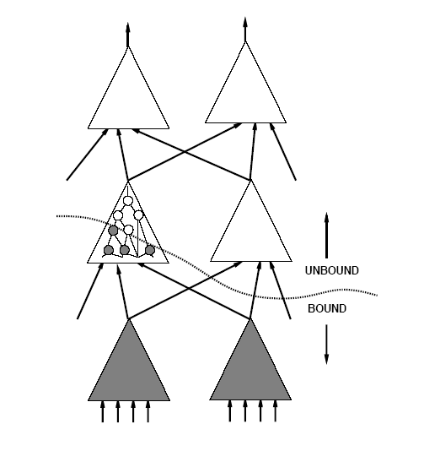
Example
Notes:
We consider first the problem of extracting the dc information of a logic network during binding.
A sketch of a partially bound network is shown above. The gray cones are fully mapped.
The interconnection of the cells in the bound portion of the network induce a satisfiability dc set (SDC).

Slide 47
Boolean matching with don’t care conditions
Given f(x), f_{DC}(x) and g(y)
  g matches f, if g is equivalent to h, where:
  f f’_{DC} ≤ h ≤ f + f_{DC}
Matching condition:
∀_{x} ( f_{DC}(x) + f(x) S_{y} ( A (x,y) g(y) ) )
⊕
Notes:
The degrees of freedom in matching the corresponding cluster function f are the impossible local input patterns and those whose effect is unobservable at the network outputs.
The pattern function can replace the cluster function if there exists a completely
specified function h that matches f modulo (i.e., plus or minus) the dc set.
The matching condition can also be restated as follows.
For every input, either this is a dc point or the cluster must match the pattern subject to an assignment.

Slide 48
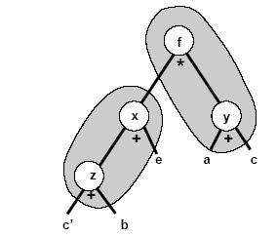
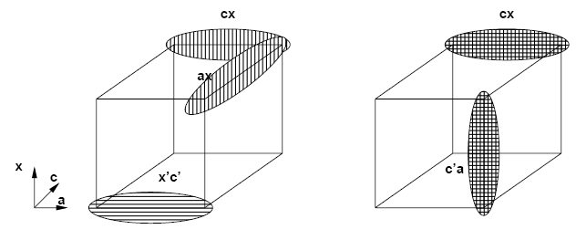
Example
Assume v_{x} is bound to an OR3(c’,b,e)
Don’t care set includes x ⊕ (c’+b+e)
Consider f_{j} = x(a+c) with CDC = x’c’
No simplification.
  Mapping into AOI gate.
Matching with DCs.
  Map to a MUX gate.
Notes:
Consider again the subject graph above.
Let us assume that vertex vx has been bound to a three-input OR gate. Hence x != (c' + b+e) = x'c' + x'b +x'e + xcb'e‘ belongs to the satisfiability dc set.
Consider now the cluster function for vertex vf, namely f = x (a +c) and its corresponding controllability dc set.
The controllability dc set expresses that portion of the SDC that is independent of the values of the variables that are not in the support of f.
Pattern x'c cannot be an input to the cluster represented by cluster function f = x (a +c).
With the dc condition, the cluster can be mapped to a multiplexer g2= cx +c’ a.

Slide 49
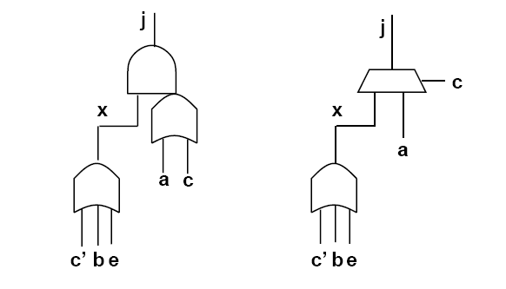
Example
Notes:
The multiplexer is smaller and faster than the AO j = x (a+c).
This solution can be found only by using the dc conditions.

Slide 50
Extended matching
Motivation:
  Search implicitly for best pin assignment
  Make a single test, determining matching and assignment
Technique:
  Construct BDD model of cell and assignments
Visual intuition:
  Imagine to place MUX function at cell inputs
  Each cell input can be routed to any cluster input (or voltage rail)
  Input polarity can be changed:
    NP-equivalence (extensible to NPN)
  Cell and cluster may differ in size
Cell and multiplexers are described by a composite function G(x,c)
  Pin assignment is determining c
Notes:
Extended matching is a technique that searches implicitly for the best pin assignment.
It avoids checking iteratively the equality of the cluster and pattern for all valid input assignments.
The idea is to create a BDD that models the pattern and the input assignment.
This can be visualized by having a multiplexer in front of all cell inputs, that can connect them to any cluster input.
Moreover, an inversion function (EXOR) can be put in place for inputs and output.
The result, is that each cell is represented by a composite function of two sets of inputs:
The cluster variable set
The control vector c, that corresponds to the pin assignment.

Slide 51
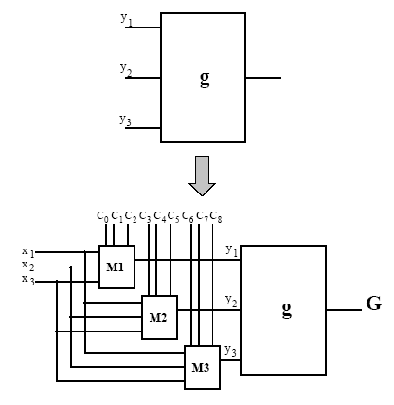
Example
g = y₁ + y₂ y’₃
y₁ (c,x) = (c₀c₁x₁ + c₀c’₁x₂ + c’₀c₁x₃) ⊕ c₂
G = y₁ (c,x) + y₂(c,x) y₃(c,x)’
An EXOR gate can be placed at the gate
output to support NPN-equivalence check
Notes:
This example shows visually the cell g, with multiplexers placed in front of it.
Some control signals can complement the inputs and the output.

Slide 52
Extended matching modeling
Model composite functions with ROBDDs
  Assume n-input cluster and m-input cell
  For each cell input:
    ┌ log₂ n ┐ variables for pin permutation
    One variable for input polarity
  Total size of c: m(┌ log₂ n┐ + 1 )
  One additional variable for output polarity
A match exists if there is at least one value of c satisfying M (c) = ∀_{x} [ G(x,c) f(x) ]
⊕
Notes:
The BDD representation of the composite function grows logarithmically with the cluster inputs and linearly with the cell inputs.
BDD technology allows tools to represent efficiently the composite function.
To test for a match, the composite function is equated to the cluster function. There are three cases:
The resulting function is void. There is no match.
The resulting function is a minterm of c. Then c spells the pin assignment
The resulting function has more than one minterm. Thus, the corresponding values for c give the possible pin assignments. A choice can be made according to specific costs functions, such as I/O delay.

Slide 53
Example
Cell: g=x’y
Cluster: f = wz’
G(a,b,c,d) = (c⊕(za+wa’))’(d⊕(zb+wb’))
F G=(wz) (c⊕(za+wa’))’(d⊕zb+wb’))
M(c) = ab’c’d’ + a’bcd
z
f
&
w
a
c
z
1
x
w
0
G
⊕
⊕
&
1
y
0
b
d
Notes:
Thus example shows a cluster and a composite function.
The match gives two outcome. The first corresponds to a “direct” connection, whereas the second corresponds to a “twisted” connection.

Slide 54
Extended matching
Extended matching captures implicitly all possible matches
No extra burden when exploiting don’t care sets
M (c) = ∀_{x} [ G(x,c) f(x) + f_{DC}(x) ]
Efficient BDD representation
Extensions:
  Support multiple-output matching
  Full library representation
⊕
Notes:
Extended matching captures implicitly all possible matches, thus avoiding their enumeration.
It can also be extended to cope with dc in a straightforward fashion, and the composite function representation is well supported by BDDs.
Extended matching has been used to support cells with two or more outputs.
The ultimate extension, is the full library representation as described next.

Slide 55
Full library model
Represent full library with L(x,c)
  One single (large) BDD
Visual intuition
  All composite cells connected to a MUX
Compare cluster to library L(x,c)
  M (c) = ∀_{x} [ L(x,c) f(x) + f_{DC}(x) ]
  Vector c determines:
    Feasible cell matches
    Feasible pin assignments
    Feasible output polarity
G₁
G₂
L
⊕
G_{n}
Notes:
The full library model consists of representing the entire library with a single BDD.
The visual intuition is that all cells outputs are connected to multiplexer, that eventually chooses the cell.
Matching consist of comparing the library function L to the cluster.
Again, if the matching is not void, the result is a function specifying all cells and all corresponding pin assignment that have a match.

Slide 56
Summary
Library binding is a key step in synthesis
Most systems use some rules together with heuristic algorithms that concentrate on combinational logic
  Best results are obtained with Boolean matching
  Sometimes structural matching is used for speed
Library binding is tightly linked to buffering and to
physical design
Notes:
Library binding is a key step in synthesis. Most systems use rules together with heuristic algorithms.
Library binding is also tightly linked to physical design, and some tools do these steps now concurrently.

